Slide 1

User Identity Exploration and Preference Prediction Using Yelp Dataset
COMP 533 FINAL PROJECT
Zheng You
Rocky Wu
Yan Xu

Slide 2
Agenda
Background & Project Goal
Exploration Method
Result
Limitation & Improvement
Conclusion

Slide 3

Background & Project Goal
Yelp is an online business review service: it lets users post reviews and rate businesses.

Slide 4
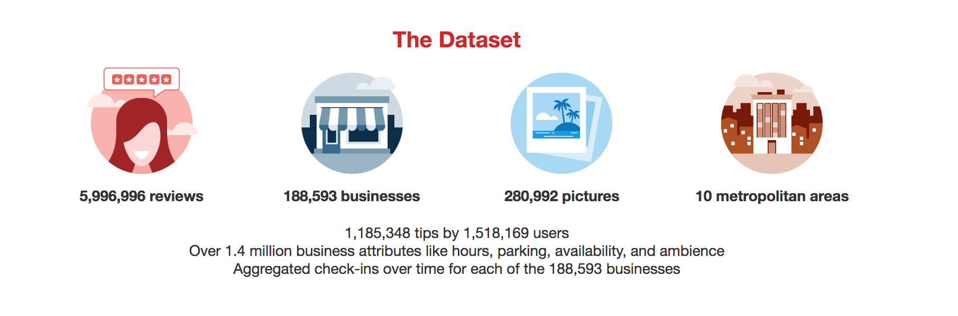
Background & Project Goal
Yelp Dataset is HUUUGE!

Slide 5
Background & Project Goal
We want to achieve the following three goals:
Identify abnormal users
Determine gender distribution and gender-rating relationship
Explore the predictive power of
Top rated restaurants in a city
Friend preferences

Slide 6
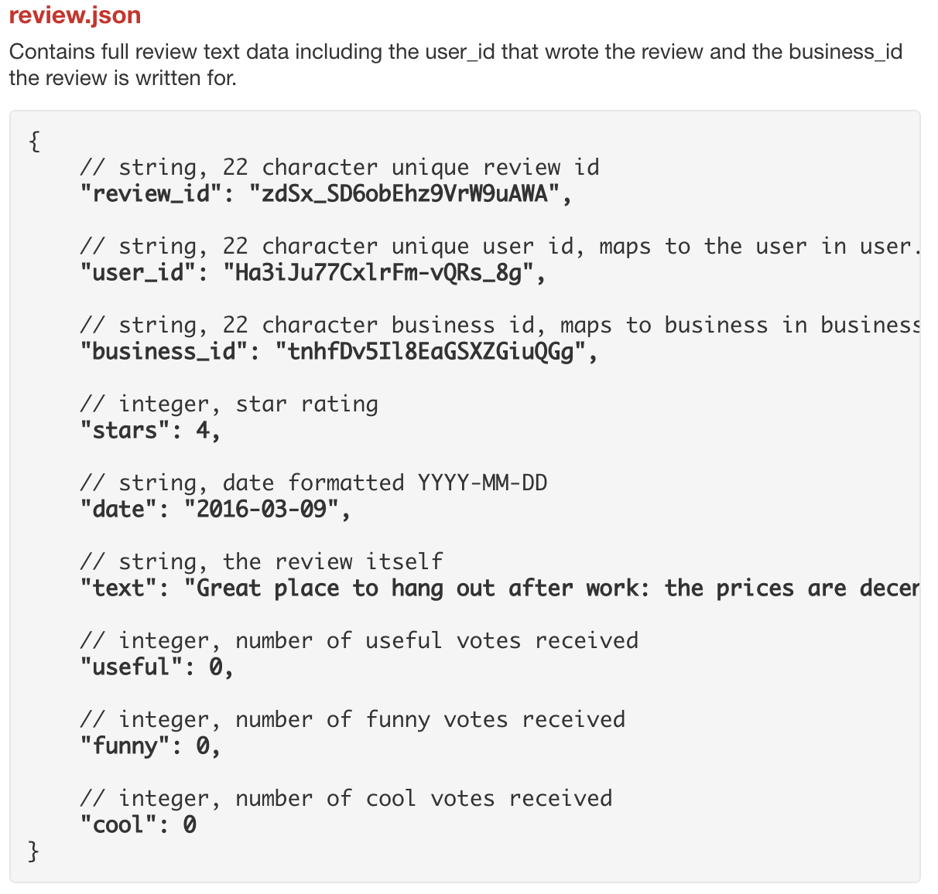
Exploration Method
Import JSON data:
Python
Create relations:
Declarative SQL
Complicated operations:
Imperative SQL

Slide 7
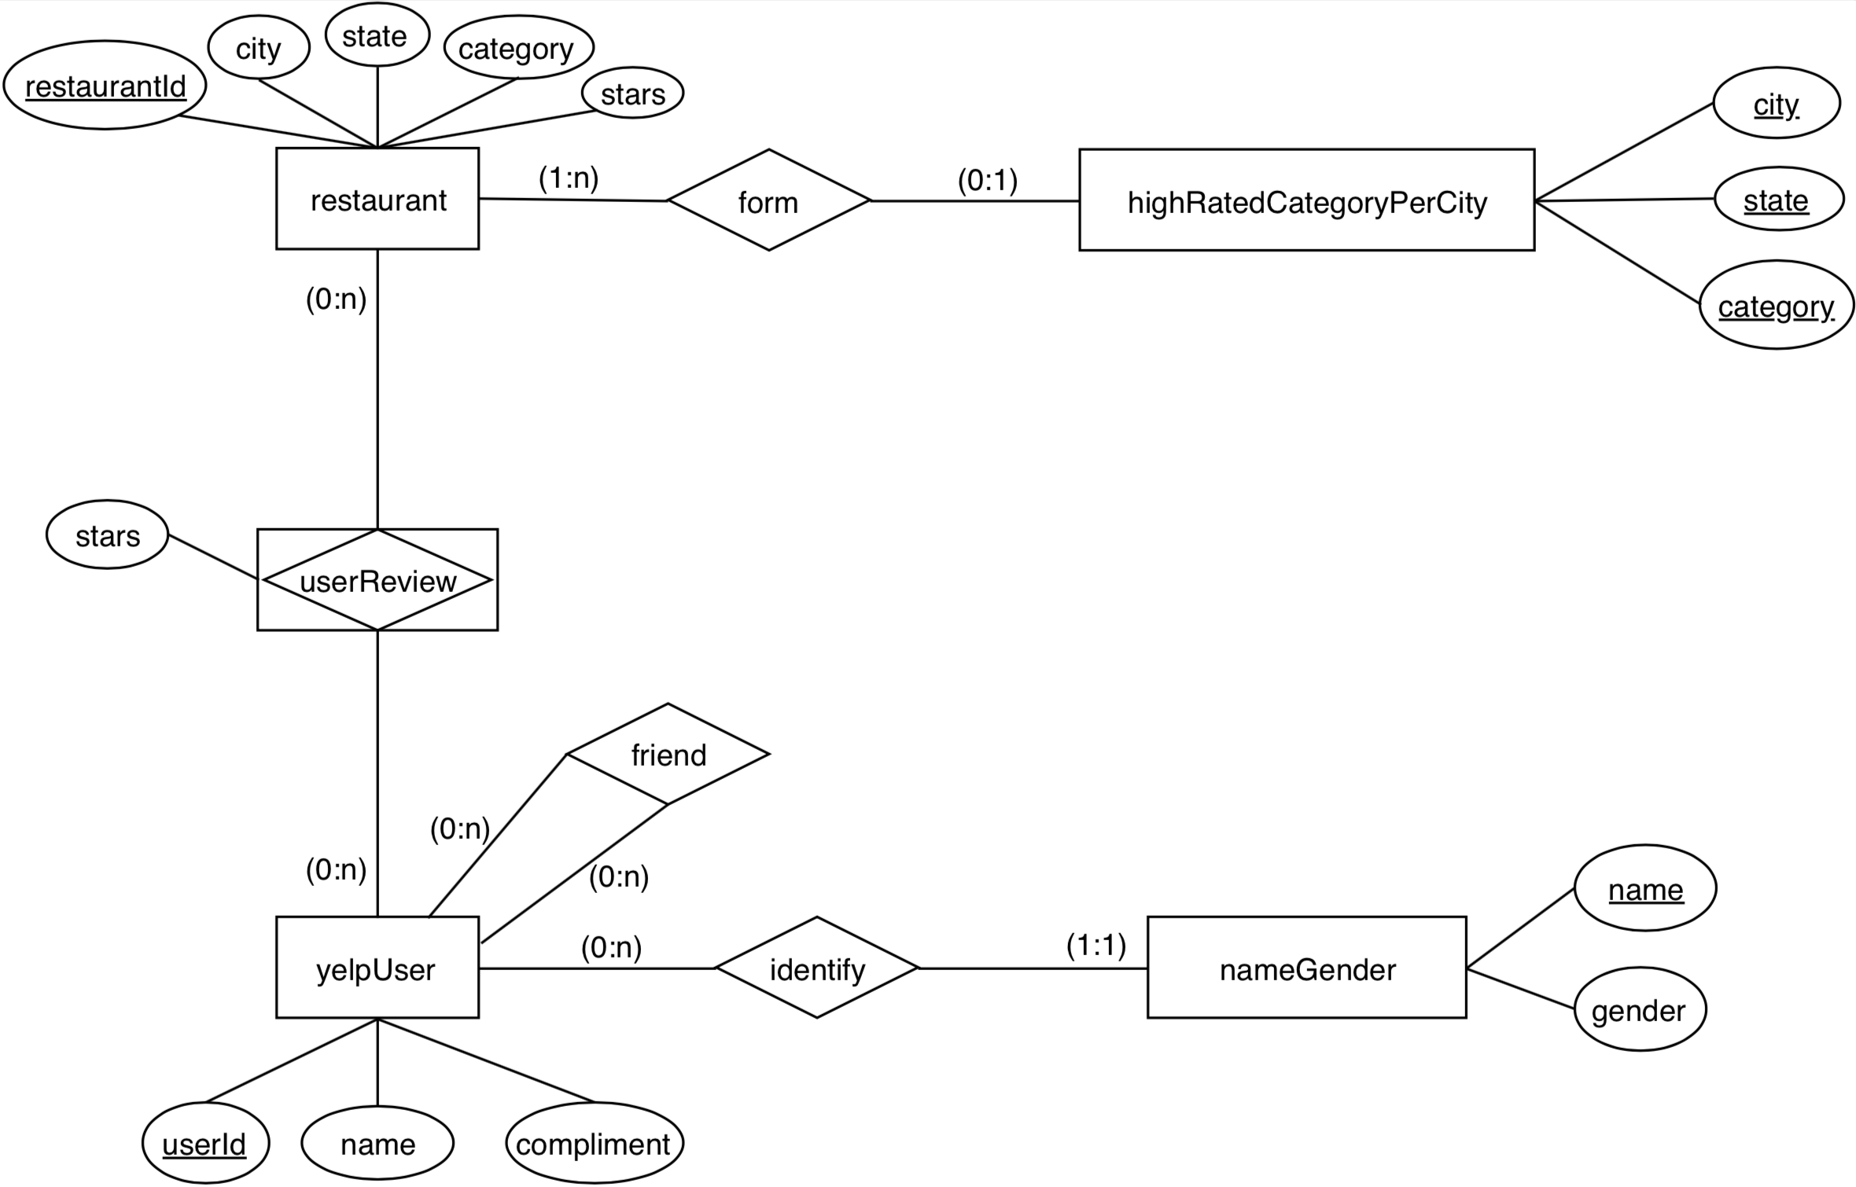
Entity-Relationship Diagram

Slide 8
Result
Abnormal User Detection
User Gender Distribution
Preference Prediction by City
Preference Prediction by Friend
Learning about Yelp users and their preferences

Slide 9
Result
Abnormal User Detection
User Gender Distribution
Preference Prediction by City
Preference Prediction by Friend
Learning about Yelp users and their preferences

Slide 10
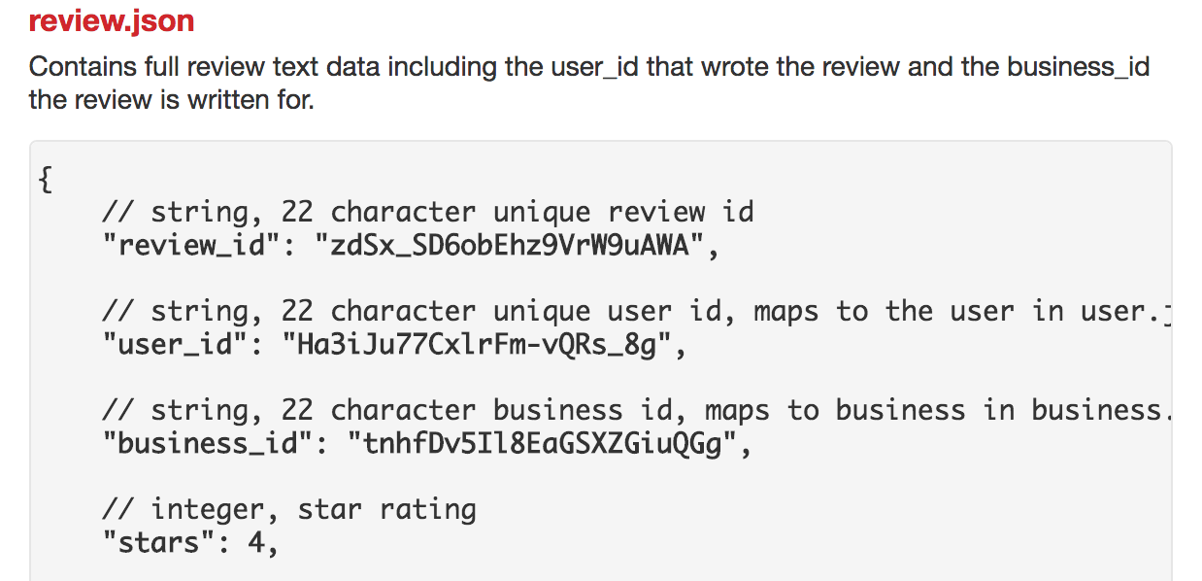
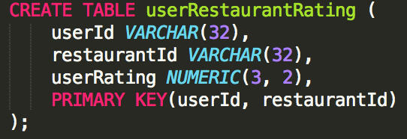
Abnormal User Detection
1. Extract a user’s rating for each restaurant she has visited.

Slide 11
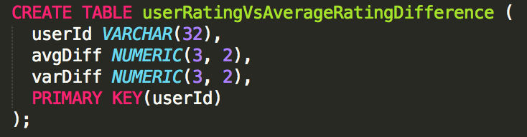
Abnormal User Detection
1. Extract a user’s rating for each restaurant she has visited.
2. Compute the absolute difference between her rating and the average rating of the restaurant. Calculate the mean and variance of these differences over all restaurants she has rated.

Slide 12
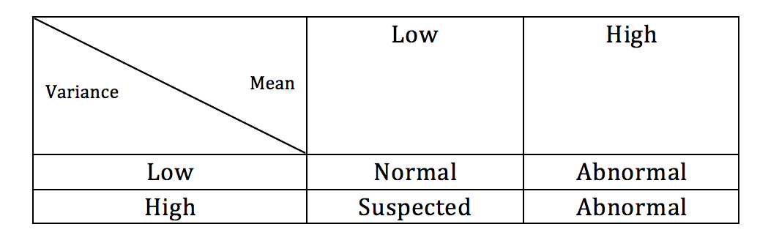
Abnormal User Detection
1. Extract a user’s rating for each restaurant she has visited.
2. Compute the absolute difference between her rating and the average rating of the restaurant. Calculate the mean and variance of these differences over all restaurants she has rated.
3. Identify abnormal users.

Slide 13
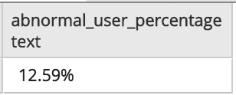
Abnormal User Detection
1. Extract a user’s rating for each restaurant she has visited.
2. Compute the absolute difference between her rating and the average rating of the restaurant. Calculate the mean and variance of these differences over all restaurants she has rated.
3. Identify abnormal users.
4. Calculate the ratio of abnormal users.

Slide 14
Result
Abnormal User Detection
User Gender Distribution
Preference Prediction by City
Preference Prediction by Friend
Learning about Yelp users and their preferences

Slide 15
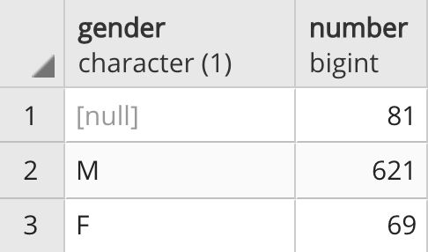
User Gender Distribution
Add an additional column “gender” to the “yelpUser” relation.
The raw dataset does not contain this information.
Adopt another data source: Baby Names from SSA (1880 - 2017)
Some names are gender-neutral, like Taylor
Vote for majority

Slide 16
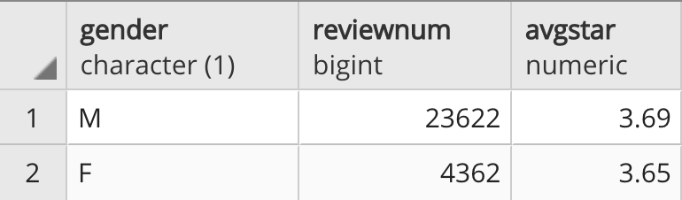
User Gender Distribution
Add an additional column “gender” to the “yelpUser” relation.
Calculate the average review count and average rating for male and female.
Ignore users with unspecified genders

Slide 17
Result
Abnormal User Detection
User Gender Distribution
Preference Prediction by City
Preference Prediction by Friend
Learning about Yelp users and their preferences

Slide 18
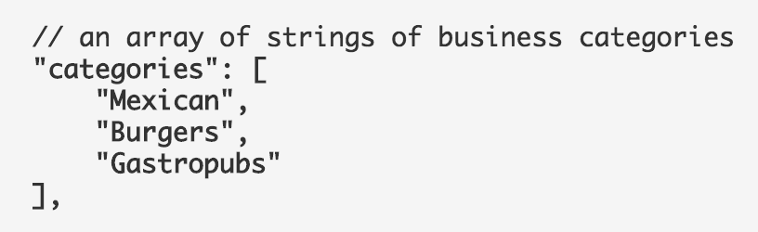
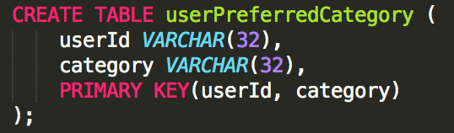
Predicting Preference by City
Find personal preference set U.

Slide 19
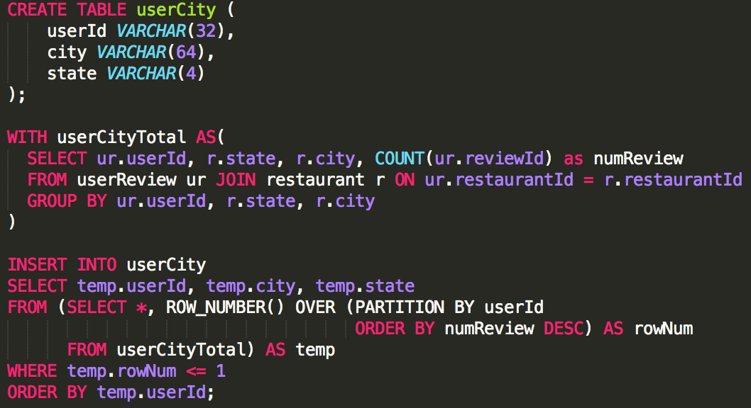
Predicting Preference by City
Find personal preference set U.
Identify the city that each user lives in or frequents the most.

Slide 20
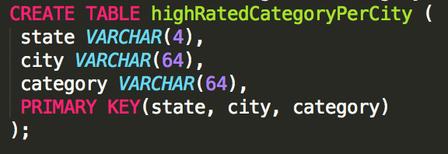
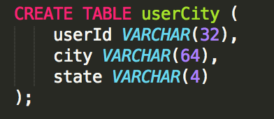
Predicting Preference by City
Find personal preference set U.
Identify the city that each user lives in or frequents the most.
Find top restaurant categories in the user’s city, called set C.
JOIN

Slide 21
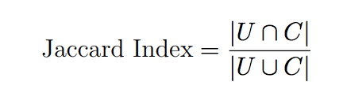
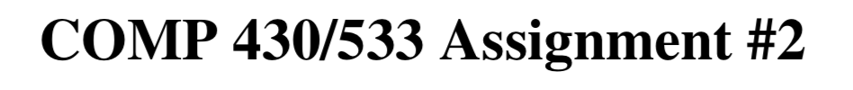
Predicting Preference by City
Find personal preference set U.
Identify the city that each user lives in or frequents the most.
Find top restaurant categories in the user’s city, called set C.
Calculate the Jaccard Index between set U and C.

Slide 22
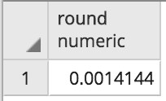
Predicting Preference by City
Find personal preference set U.
Identify the city that each user lives in or frequents the most.
Find top restaurant categories in the user’s city, called set C.
Calculate the Jaccard Index between set U and C.
Aggregate the index over all users and calculate the average.

Slide 23
Result
Abnormal User Detection
User Gender Distribution
Preference Prediction by City
Preference Prediction by Friend
Learning about Yelp users and their preferences

Slide 24
Preference Prediction by Friend
Identify user friend cycles.
A friend cycle is group of people where everyone knows at least one person in the group.
A connected component problem!
Easiest algorithm: Breadth First Search (BFS)
The result is stored in relation friendCycle(friendCycleId, userId)

Slide 25
Preference Prediction by Friend
Identify user friend cycles.
Find recommended categories from the user’s friend cycle, called set F.
Iterate through the friend cycle
Find categories recommended most by friends

Slide 26
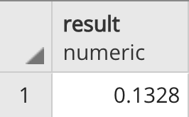
Preference Prediction by Friend
Identify user friend cycles.
Find recommended categories from the user’s friend cycle, called set F.
Calculate the Jaccard Index between set U and F.
Aggregate the index over all users and calculate the average.

Slide 27
Limitation & Improvement
Yelp Dataset...
Request more comprehensive data
Abnormal User Detection...
Metrics for determining abnormal user are somewhat arbitrary
Used absolute difference to check deviance. Could have used numeric difference for more temperament analysis
Predicting Preference…
Could include all categories for a restaurant

Slide 28
Conclusion
Abnormal Users
On average 12.6% users differ from the average rating of restaurant by more than 1 star!
Gender Distribution
Males give more reviews than females.
But they have the same average ratings.

Slide 29
Conclusion
Preference Prediction by City
Average Jaccard Index is 0.0014, indicating poor preference predictive power
Preference Prediction by Friends
Average Jaccard Index is 0.1328, relatively good predictive ability compared with prediction by city

Slide 30
Thank you!

